Slide 1
Eclipse IDE vs. Visual Studio IDE
By: Amanda Sedgwick

Slide 2
Introduction
IDEs are one of the most important tools for developers
Report compares 2 popular IDEs
Eclipse vs. Visual Studio
Research consists of:
Decisions in design development
IDEs and More
Vital Features of IDEs
Specific features of Eclipse vs. Visual Studio
Comparison of features on 5- star rating scale

Slide 3
Introduction Continued
Research Question:
Which Popular IDE in Computer Science is better Visual Studio or Eclipse?
Reason I chose this topic:
I am studying Web Development
I use Visual Studio frequently
I’ve only used Eclipse briefly
benefits of eclipse and more about the IDE in general
Find out more about Visual Studio
Type of analytical report:
Comparative Analysis

Slide 4
Decisions in Design Development
Before using an IDE, it is good practice to construct a design document
A design document is a basic outline of the program code to prepare the way the code should be written to follow the intended design resulting in successful execution

Slide 5
IDEs and More
General Information about IDEs
An IDE is an integrated development environment
It provides necessary tools for developers to:
Build code
Correct errors
Compile code
Compiling is the process where the developers code is read and translated by the computer and the code is executed.
Example : the computer will output “Hello World!”
Both Eclipse and Visual Studio IDEs provide these features to developers that use these IDEs

Slide 6
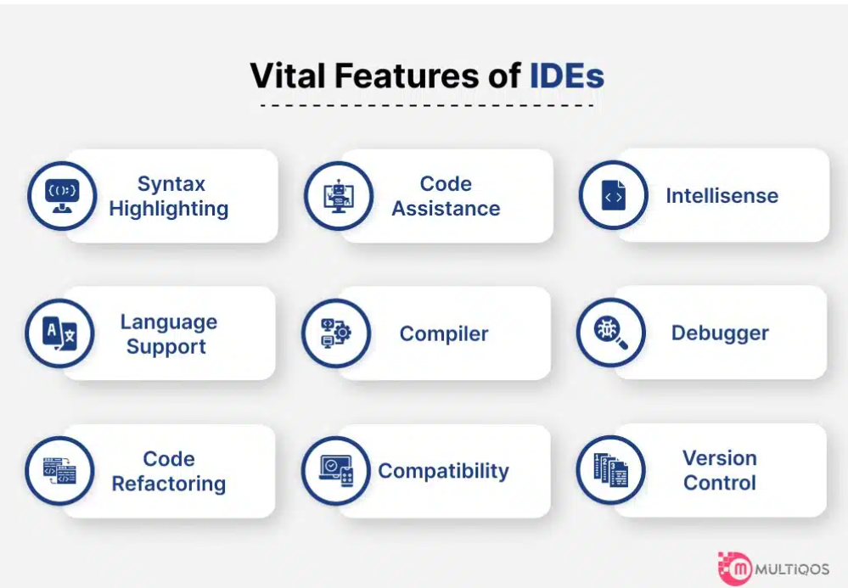
Figure 1: Vital Features of IDEs

Slide 7
Vital Features of both Eclipse and Visual Studio
Both Eclipse and Visual Studio offer developers the following features:
Code assistance helps with code completion, syntax highlighting and raises errors to be addressed.
IntelliSense is the functionality of code completion, gives suggestions
Language Support - typically, a popular IDE can support over 50 different coding languages.
A compiler aids in execution of code by communicating the code interpretation to the computer.

Slide 8
Vital Features of both Eclipse and Visual Studio Continued
Debugging tools :
Assist in error resolution
Providing suggestions and clues and ability to “Step Through” code
Code Refactoring :
Ability to adjust code without affecting output or functionality of code.
Helps increase efficiency and readability.
Compatibility:
IDEs support a wide array of languages and extensions.
Version Control :
Supports efficiency and the tracking of changes to code

Slide 9
Eclipse IDE
About Eclipse IDE
Eclipse Foundation is Non-Profit
Eclipse Theia:
Released in 2020
Extensible platform allows for customizations
Can run on desktop and cloud
Runs front end and backend processes
Allows extensions for a variety of coding languages
IntelliSense and debugging

Slide 10
Visual Studio IDE
About Visual Studio IDE
Productive, modern and innovative
Can run on desktop and cloud
IntelliSense (code suggestions)
Integrated debugging
Runs front end and backend processes
“Live Share” unique to Visual Studio IDE
Allows teams of developers to Share, exchange and update code in real time.

Slide 11
Comparing the two IDEs:
Five Star Rating Comparison
Eclipse
Visual Studio
Eclipse IDE has 180 reviews and a 4.34/5-star rating overall.
Eclipse’s ease-of-use rating is 4/5
Both IDEs scored 4.5/5-star rating for Value for money.
Both also scored 4/5 for customer support.
In addition, both IDEs received the same rating for Functionality at 4.5/5 stars.
Microsoft Visual Studio has 2885 reviews and a 4.62/5-star rating overall.
Visual Studio’s ease-of-use rating is 4.5/5
Both IDEs scored 4.5/5-star rating for Value for money.
Both also scored 4/5 for customer support.
In addition, both IDEs received the same rating for Functionality at 4.5/5 stars.

Slide 12
Eclipse and Visual Studio Pros and Cons
Eclipse Pros
Visual Studio Pros
Easy to use GUI (Graphical User Interface), which is basically the interaction between the user and the computer.
Another Pro of Eclipse is that it has reliable integration and multiple options for “Plug ins” or extensions to utilize additional features
It is easy to use and easy to start/create projects.
It has also helped developers improve the quality of software through code analysis
Visual Studio Cons
Eclipse Cons
Upgrading Versions may be difficult, and it is a little outdated.
If developers are not familiar with using this IDE, it might be difficult to navigate the project explorer.
It may be a boring coding process because it doesn’t have “Plug ins”.
Some developers have also complained of Visual Studio lagging, resulting in having to restart the software to resolve

Slide 13
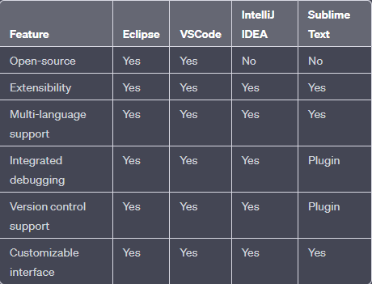
Figure 2: Visual rating comparison of Eclipse vs. Visual Studio

Slide 14
Comparing Features of Eclipse and Visual Studio
Features of Eclipse
Features of Visual Studio
Plugins
Compatible with wide range of programming languages
Open-source with integrated tools
Debugging
Code refactoring
Auto completion
Supports various extensions
Compatible with variety of programming languages
Open-source with tools
IntelliSense
Debugging
Code completion
Lightweight
Fast
Very similar features
Both open – source
Compatible with extensibility
Offer Multi-language support on customizable interface

Slide 15
Conclusion
Design decisions are vital to preparation
Both Eclipse and Visual Studio IDEs offer:
Code editors
Compilers
Debuggers
Vital Features of an IDE:
Syntax highlighting
Language support
Code refactoring
Code assistance
Compiler
IntelliSense
Compatibility
Debugging tools
Version control

Slide 16
Conclusion Continued
Eclipse offers:
Variety of plugins, allows customizations, run on desktop and cloud, compatible with wide array of programming languages
Visual Studio offers:
Productive, easy to use, modern, innovative, offers “Live Share”, Compatible with wide range of programming languages
Both IDEs have very similar features
Both scored similar ratings
Recommendation:
Visual Studio is the better IDE
Offers the same features as Eclipse
More simplistic layout design
Easier for beginners to use
Offers newly added features: “Live Share”
Has made many improvements over time
Accommodating to continuously changing technology

